Slide 1
Chongqing University of Technology
ATAI
Advanced Technique of Artificial Intelligence
Chongqing University of Technology
QA-GNN: Reasoning with Language Models and Knowledge Graphs
for Question Answering
Michihiro Yasunaga Hongyu Ren Antoine Bosselut
Percy Liang Jure Leskovec
Stanford University
{myasu,hyren,antoineb,pliang,jure}@cs.stanford.edu
Code: https://github.com/michiyasunaga/qagnn
ACL_2021
Reported by Xinsheng Wang

Slide 2
Chongqing University of Technology
ATAI
Advanced Technique of Artificial Intelligence
Chongqing University of Technology
1.Introduction
2.Method
3.Experiments

Slide 3
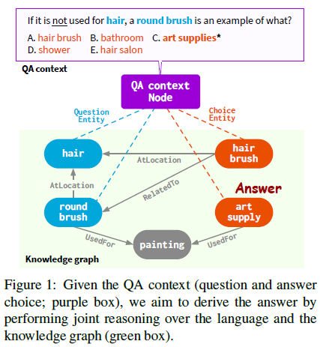
Introduction
引入噪音

Slide 4
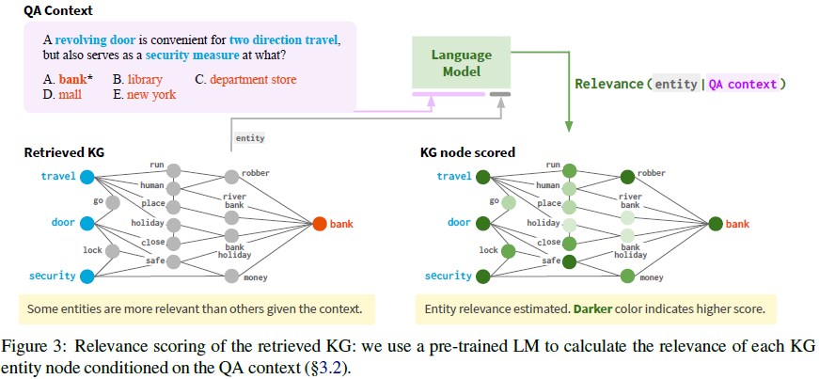
Method
Joint graph representation
EMNLP_2020_Scalable Multi-Hop Relational Reasoning for Knowledge-Aware Question Answering
KG node relevance scoring
Notes:
KG中节点embedding：将实体通过LM的embedding和通过多跳邻居表示加强自身表示之后的embedding加和

Slide 5
Method
GNN architecture

Slide 6
Method
Inference&Learning

Slide 7
Experiments
Datasets

Slide 8
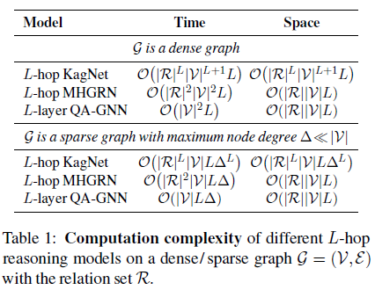
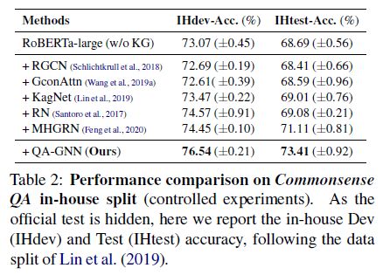
Experiments

Slide 9
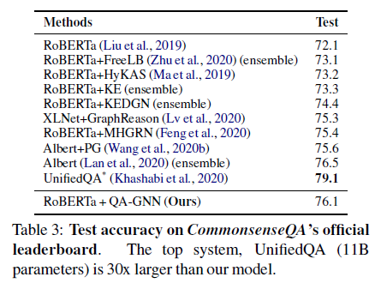
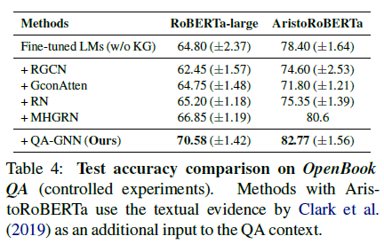
Experiments

Slide 10
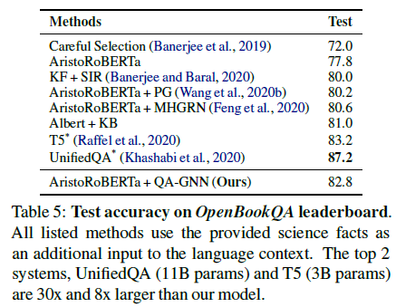
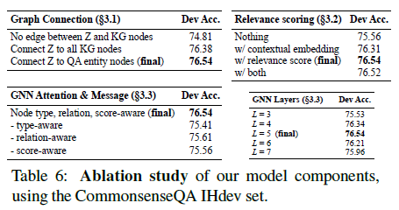
Experiments

Slide 11
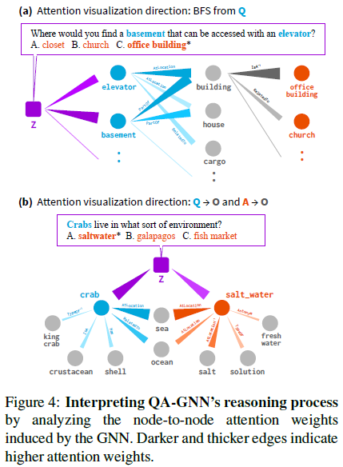
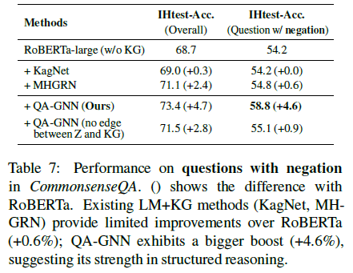
Experiments

Slide 12
Experiments

Slide 13
Experiments

Slide 14
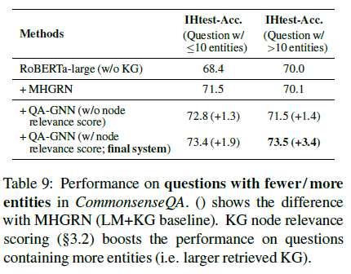
Experiments

Slide 15
Thank you!

